Slide 1
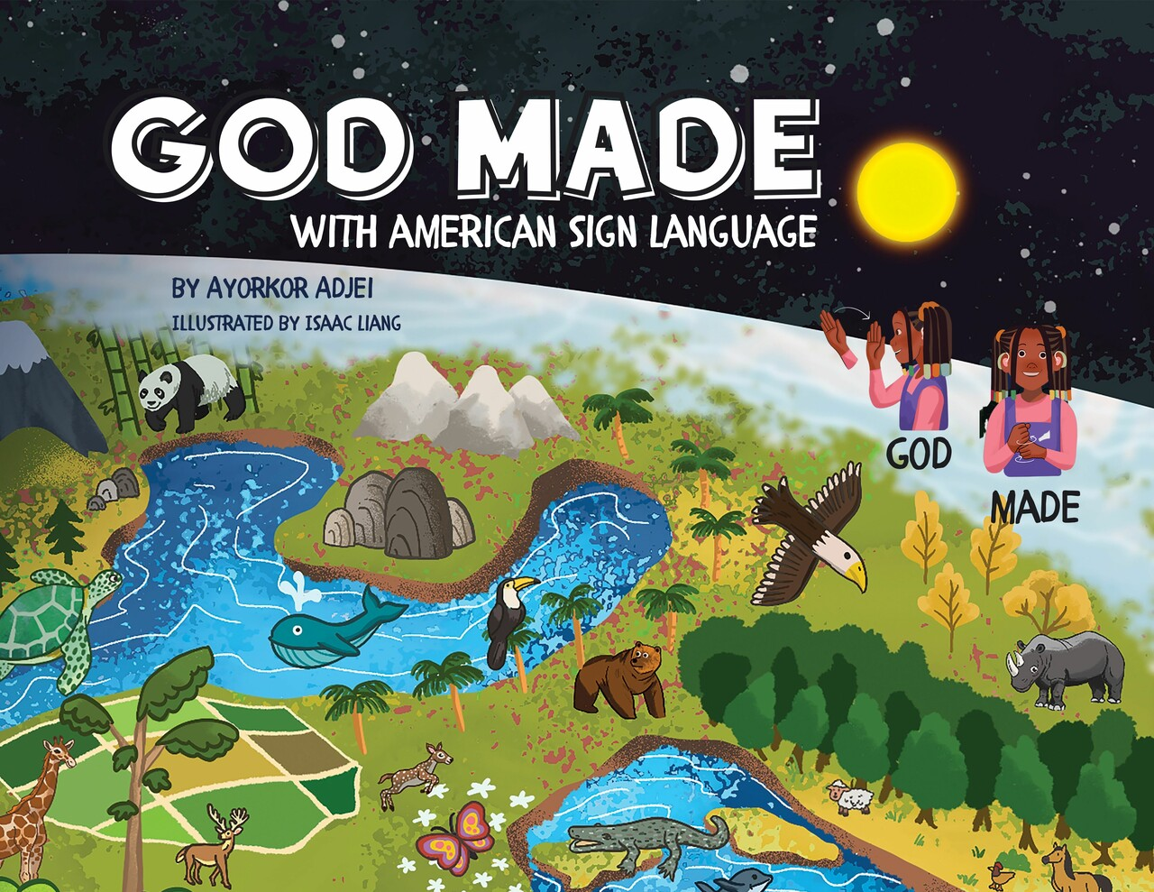
God Made
(with American Sign Language)

Slide 2
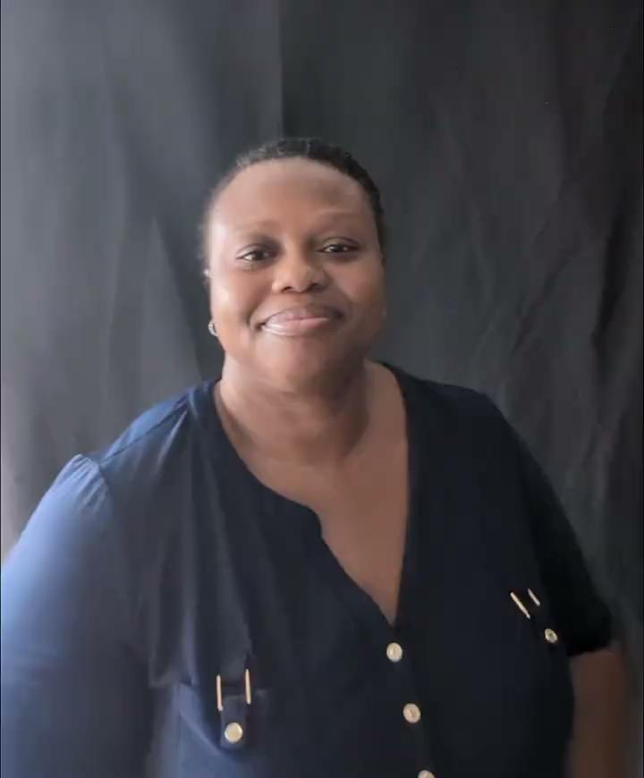
Welcome

Slide 3
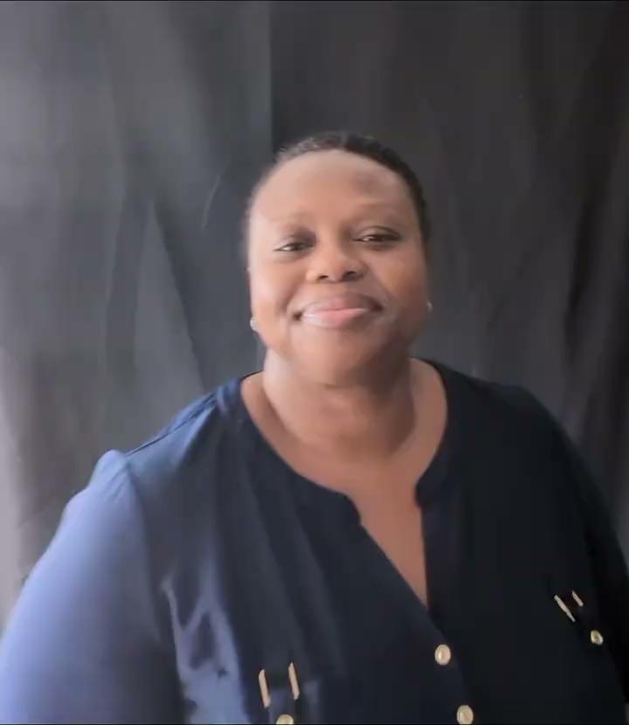
God Made
(with American Sign Language)

Slide 4
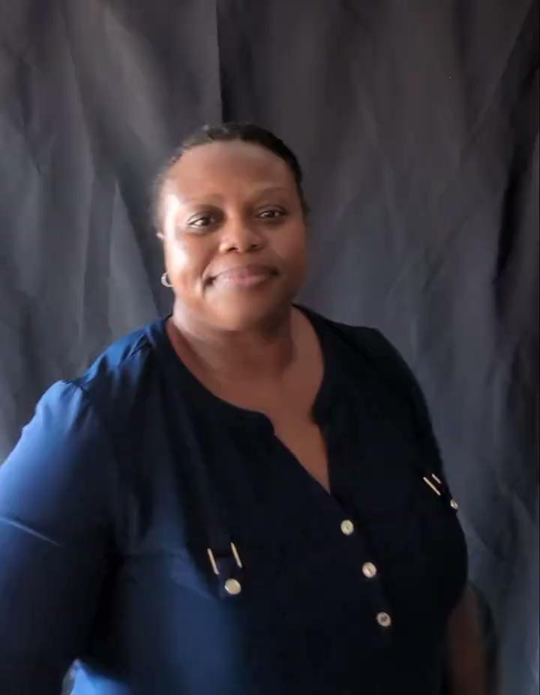
God

Slide 5
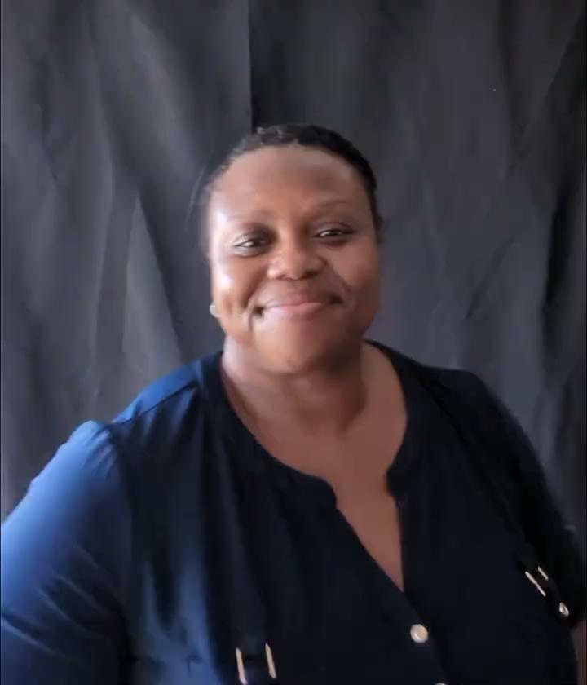
Made

Slide 6
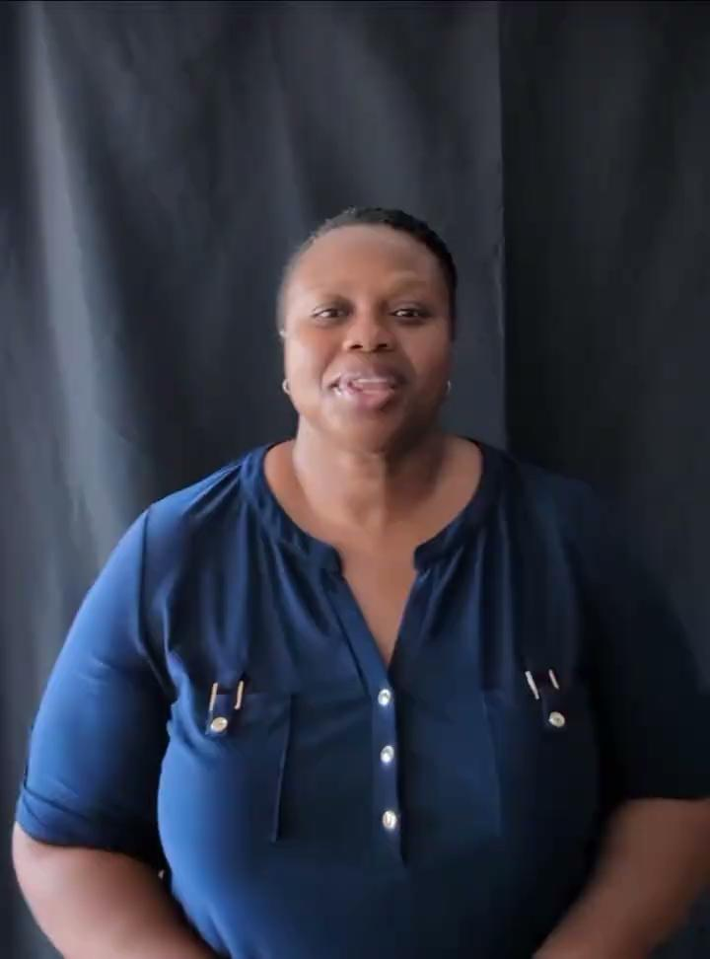
with

Slide 7
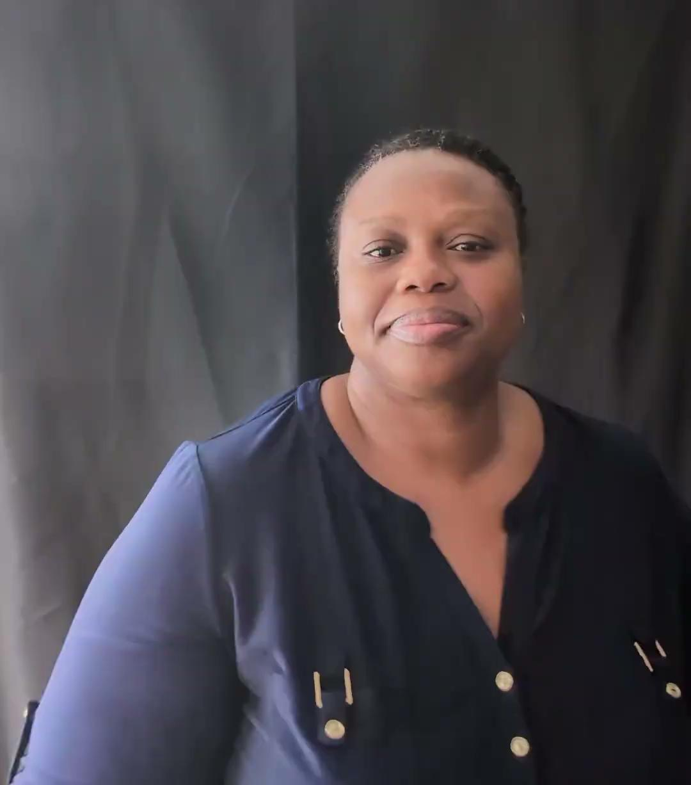
American
Sign
Language

Slide 8
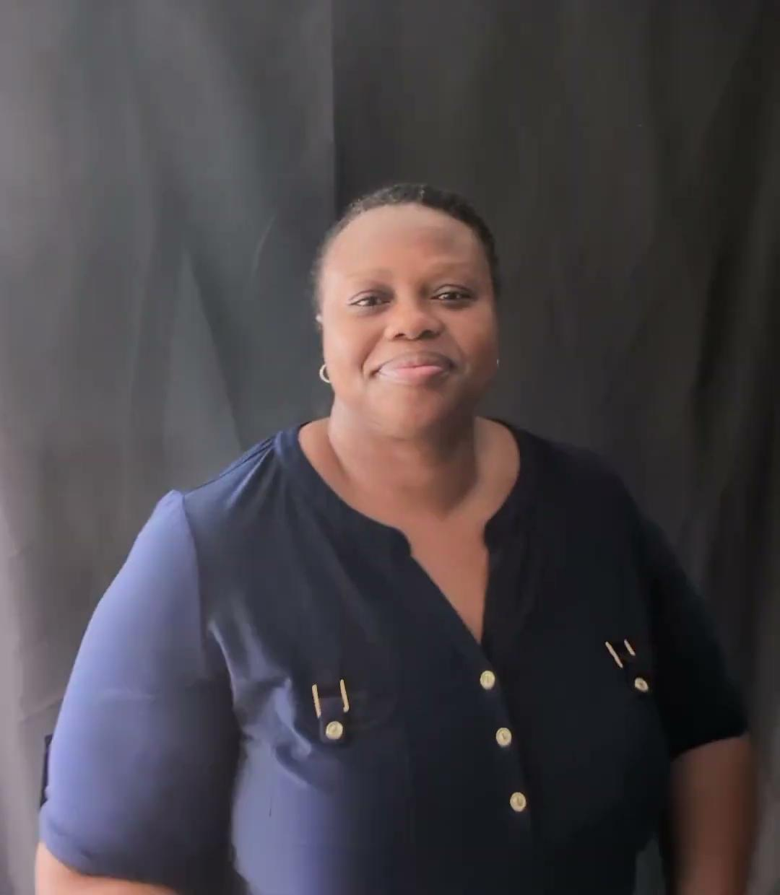
Vocab. 1
“God & Creation”
God, made, everything, a long time ago

Slide 9
God

Slide 10
made

Slide 11
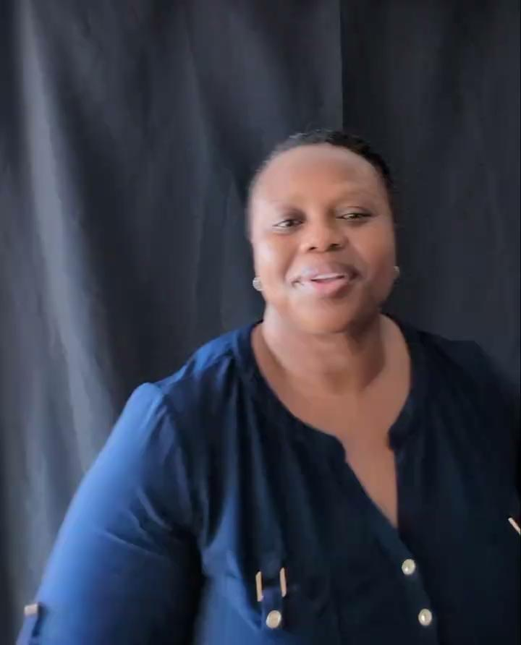
everything

Slide 12
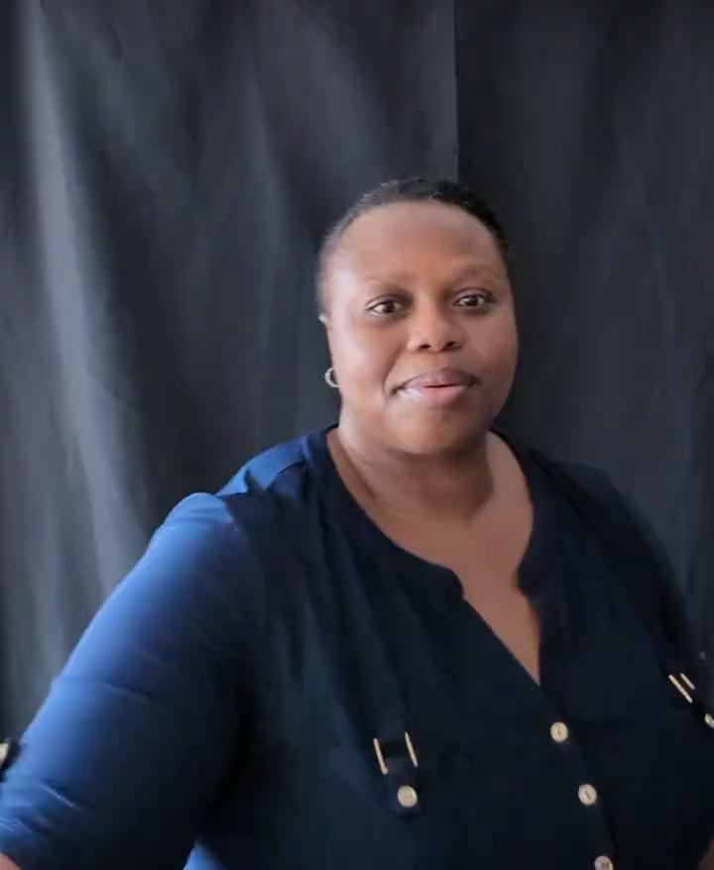
a long
time
ago

Slide 13
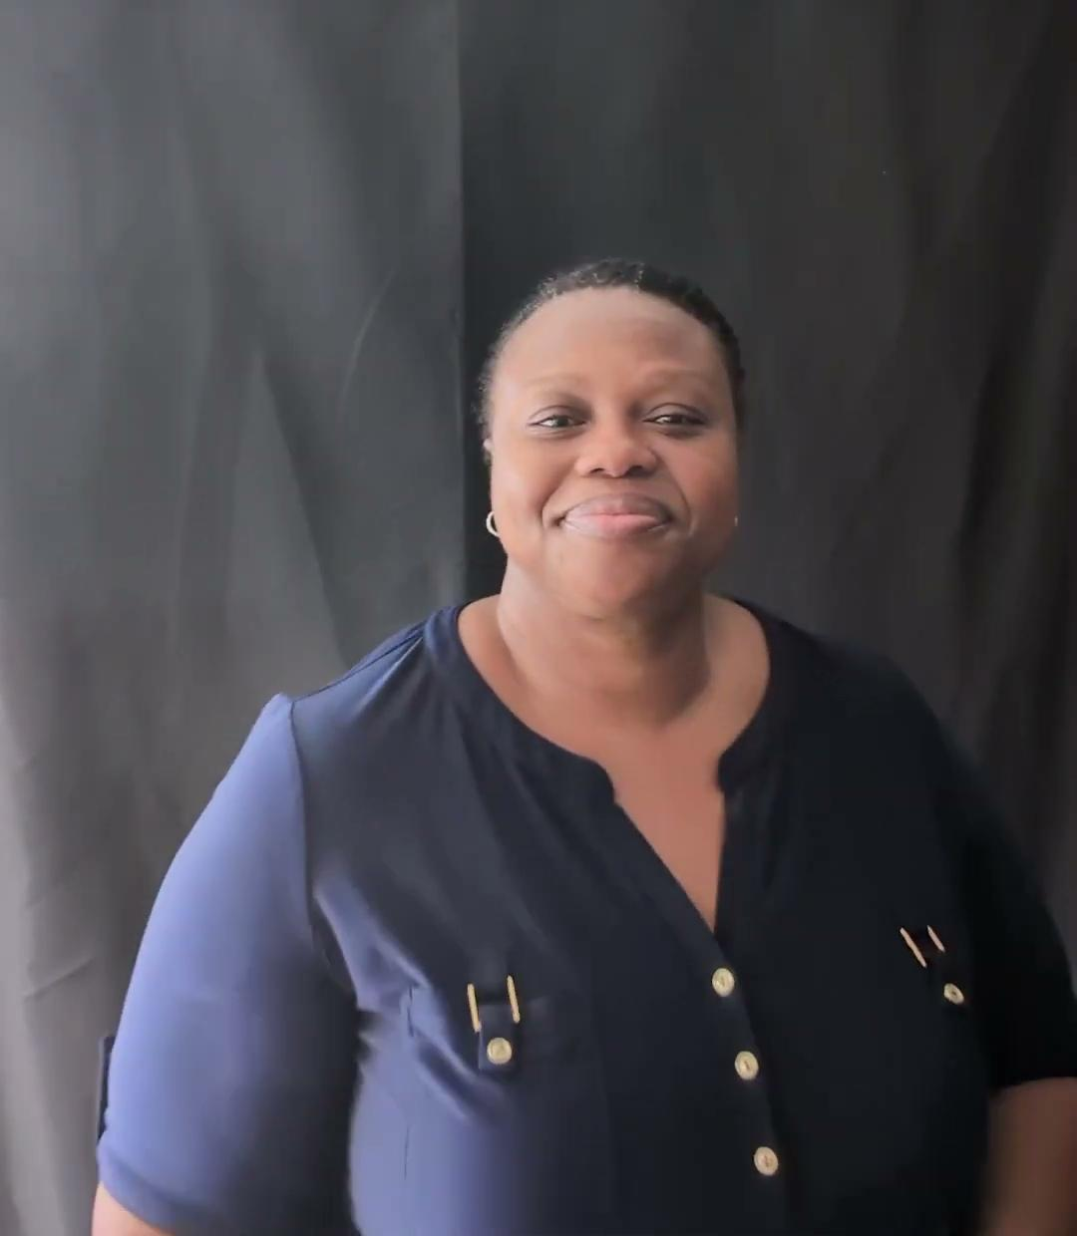
Vocab. 2
“Light, Sky, & Weather”
day, night, sun, moon, star, and sky

Slide 14
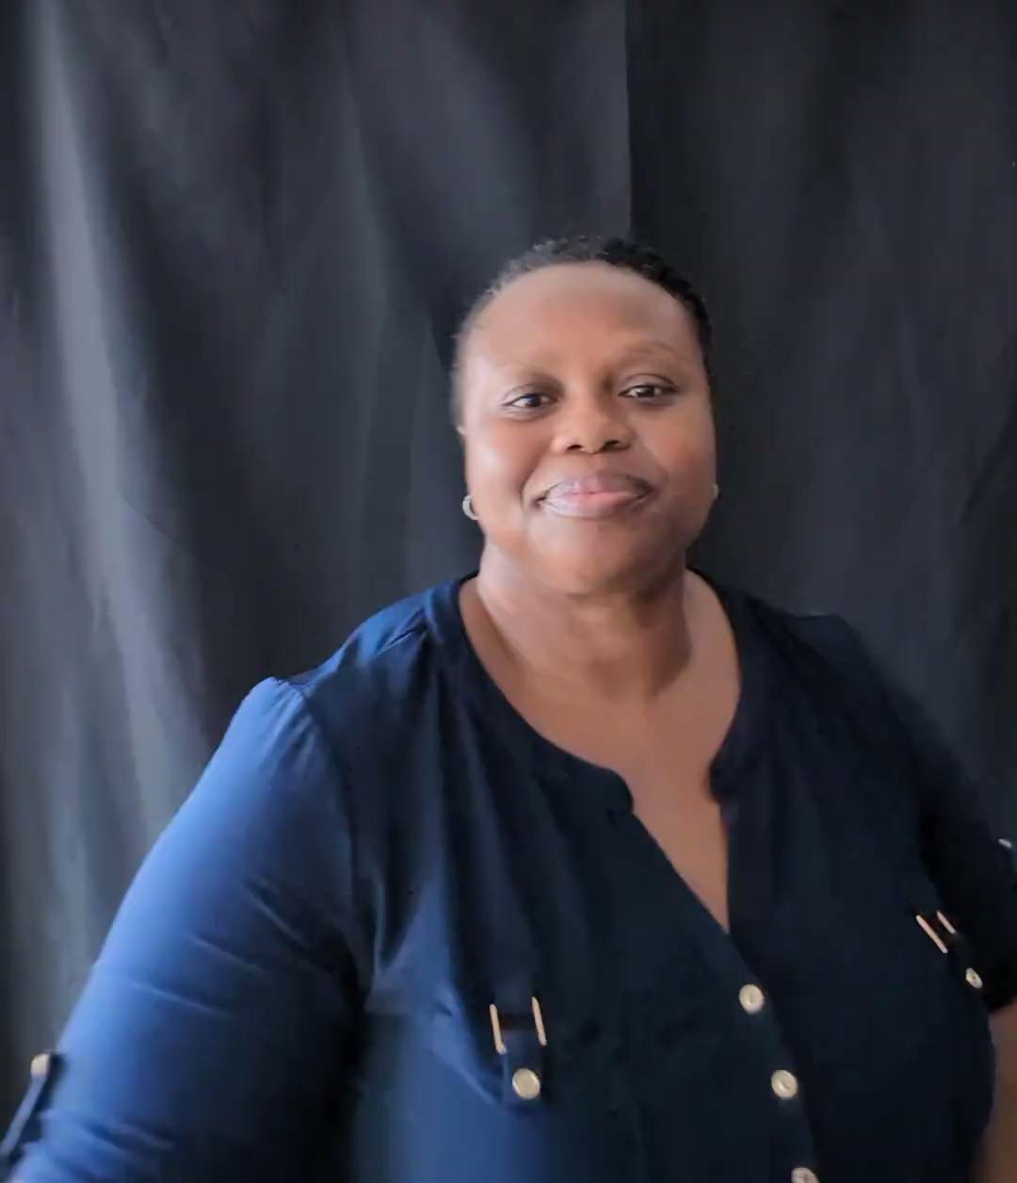
day

Slide 15
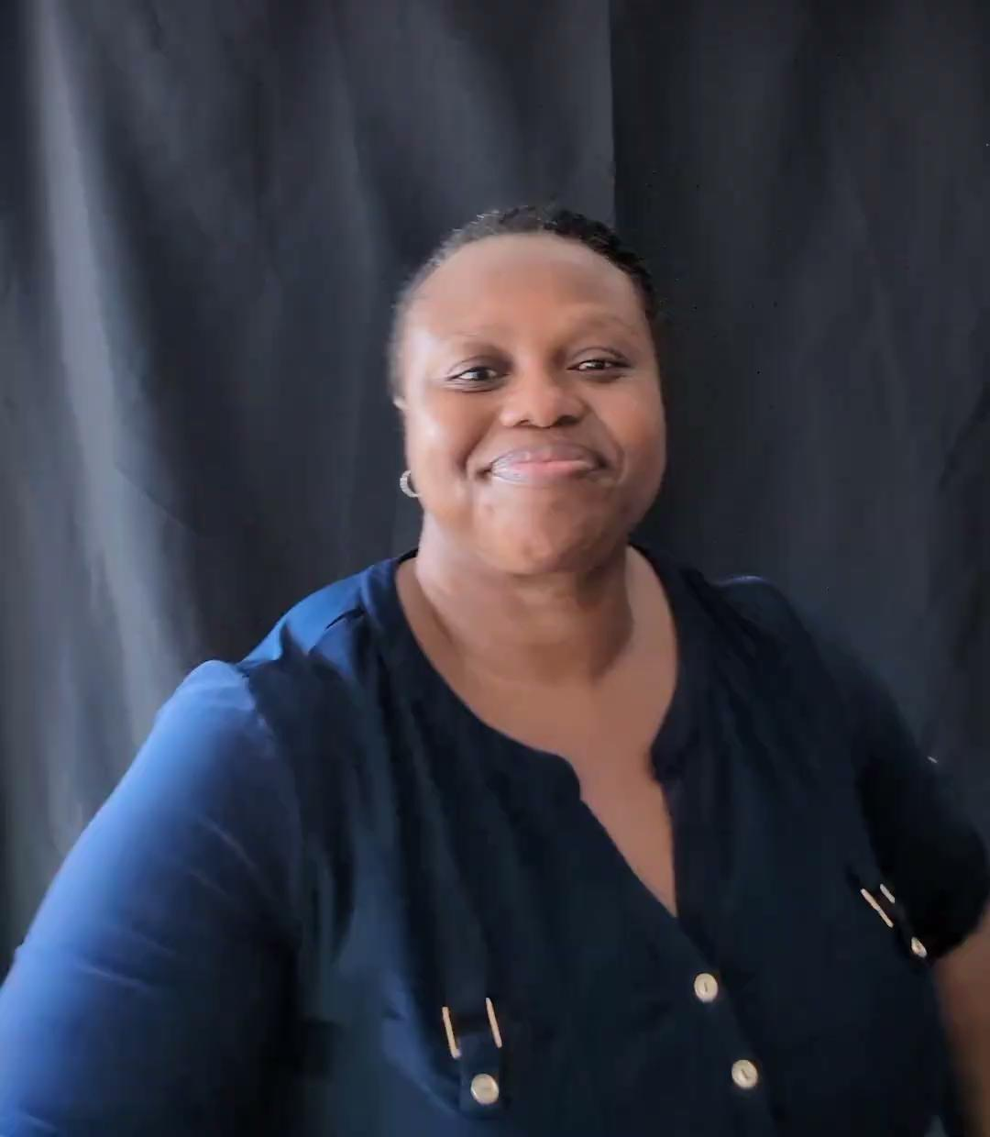
night

Slide 16
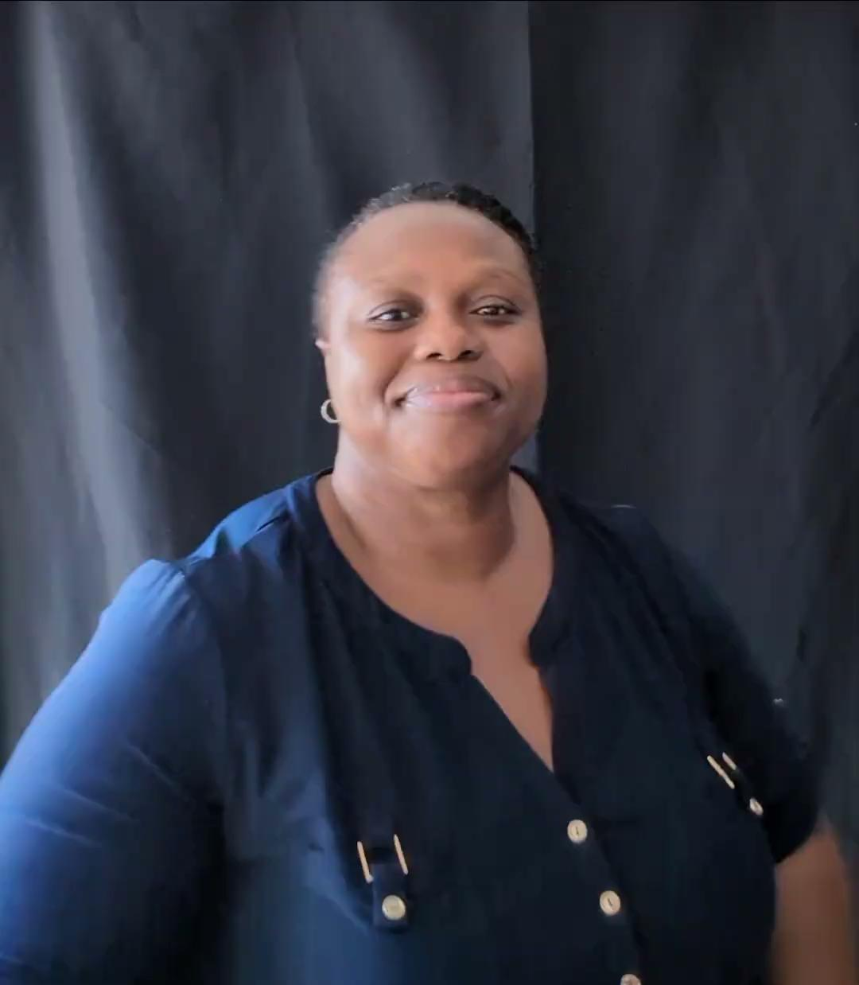
sun

Slide 17
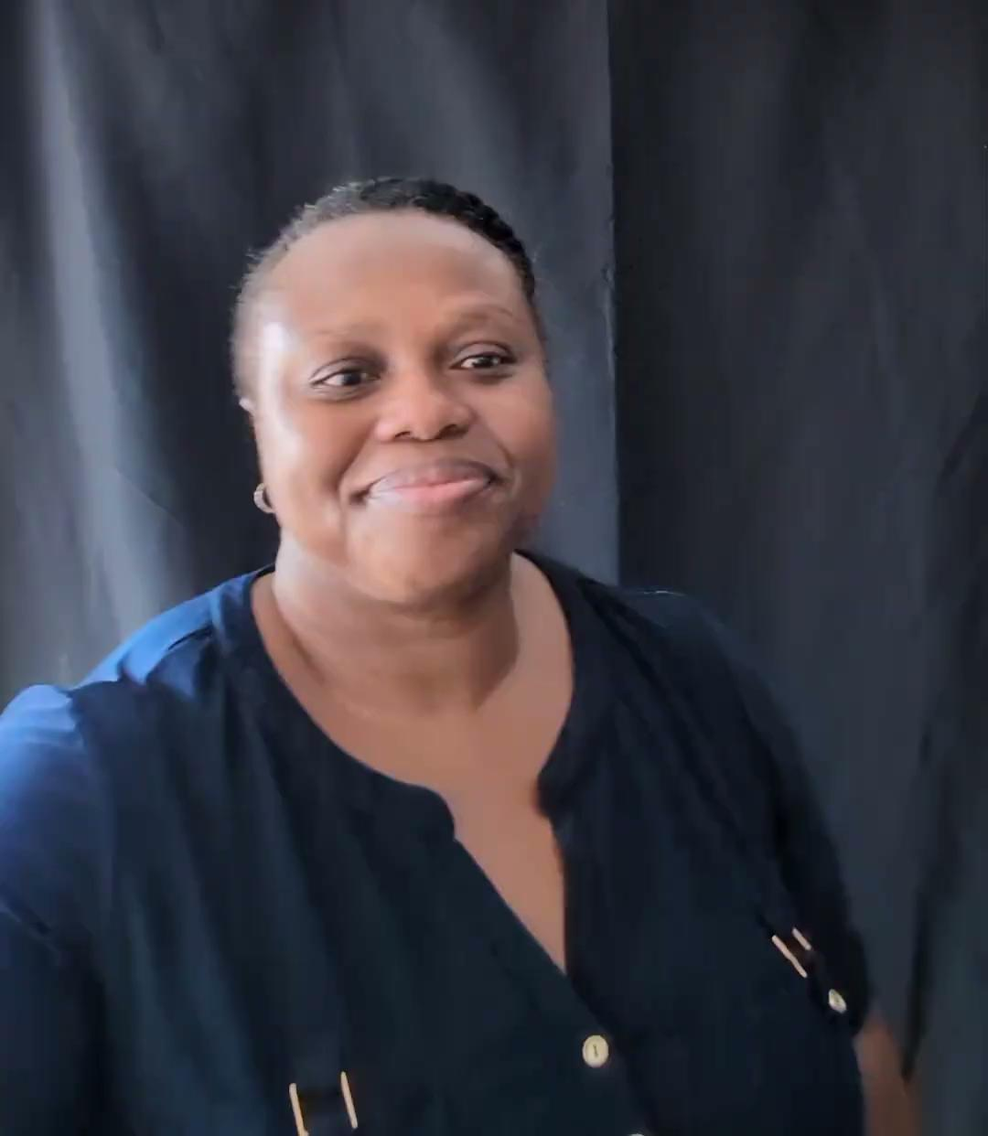
moon

Slide 18
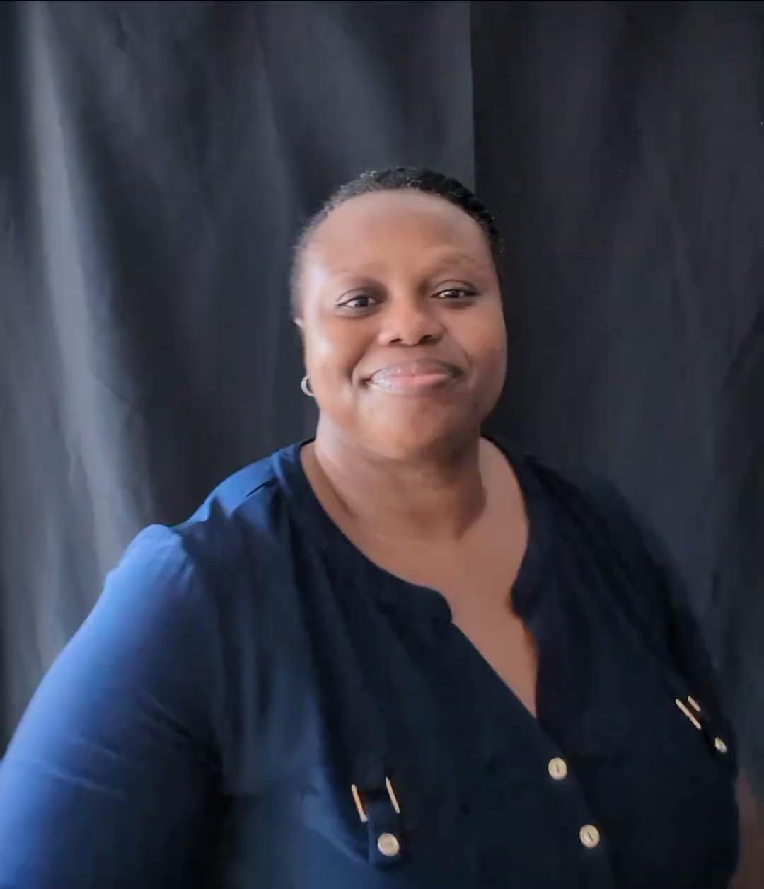
star

Slide 19
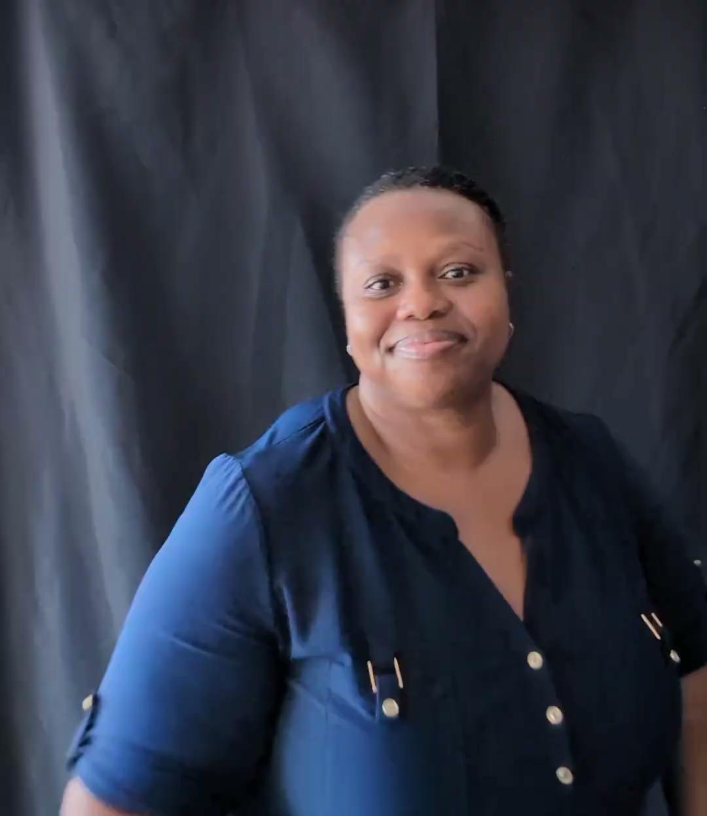
sky

Slide 20
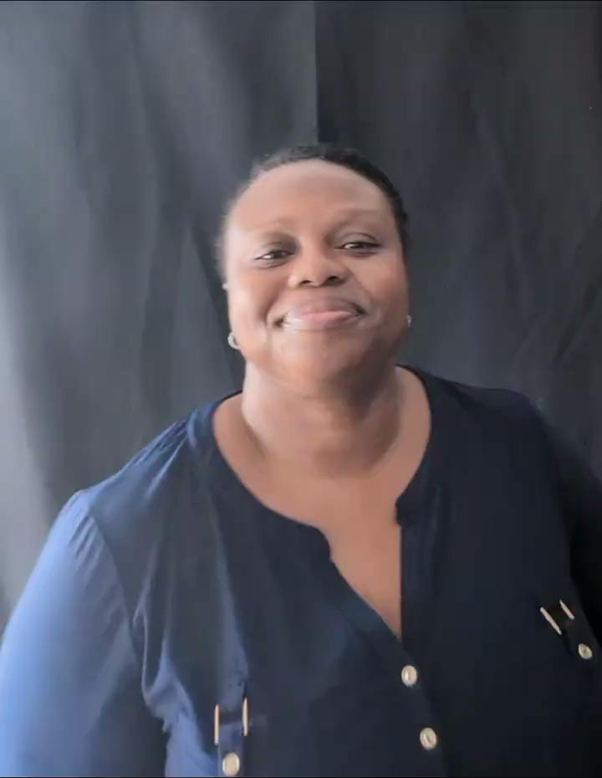
Vocab. 3
“Earth, Water, & Plant”
earth, ocean, rain, tree, plant, and cloud

Slide 21
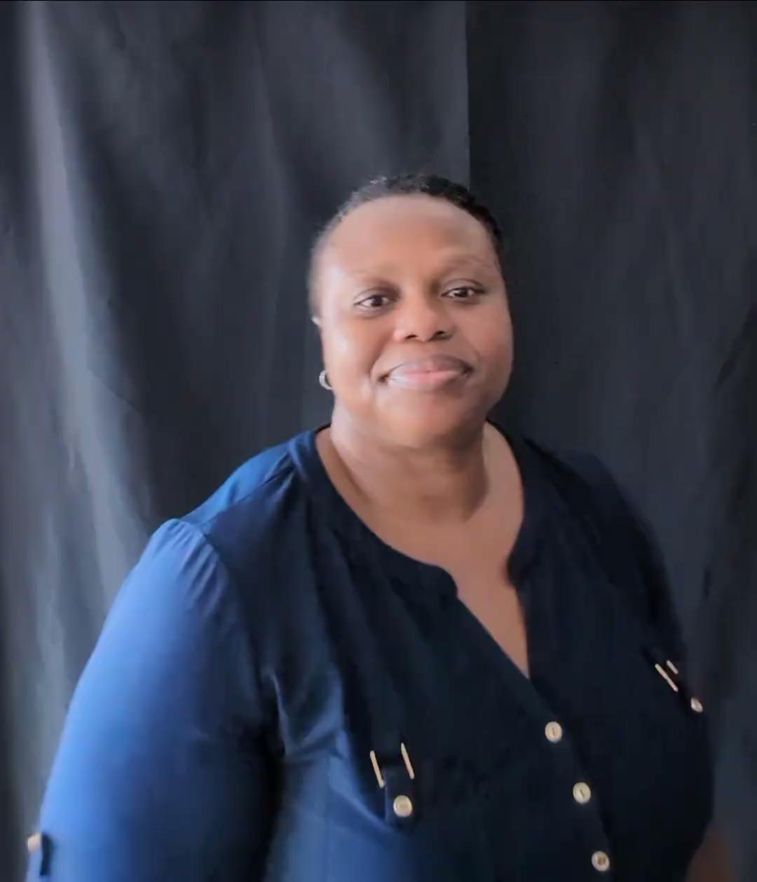
earth

Slide 22
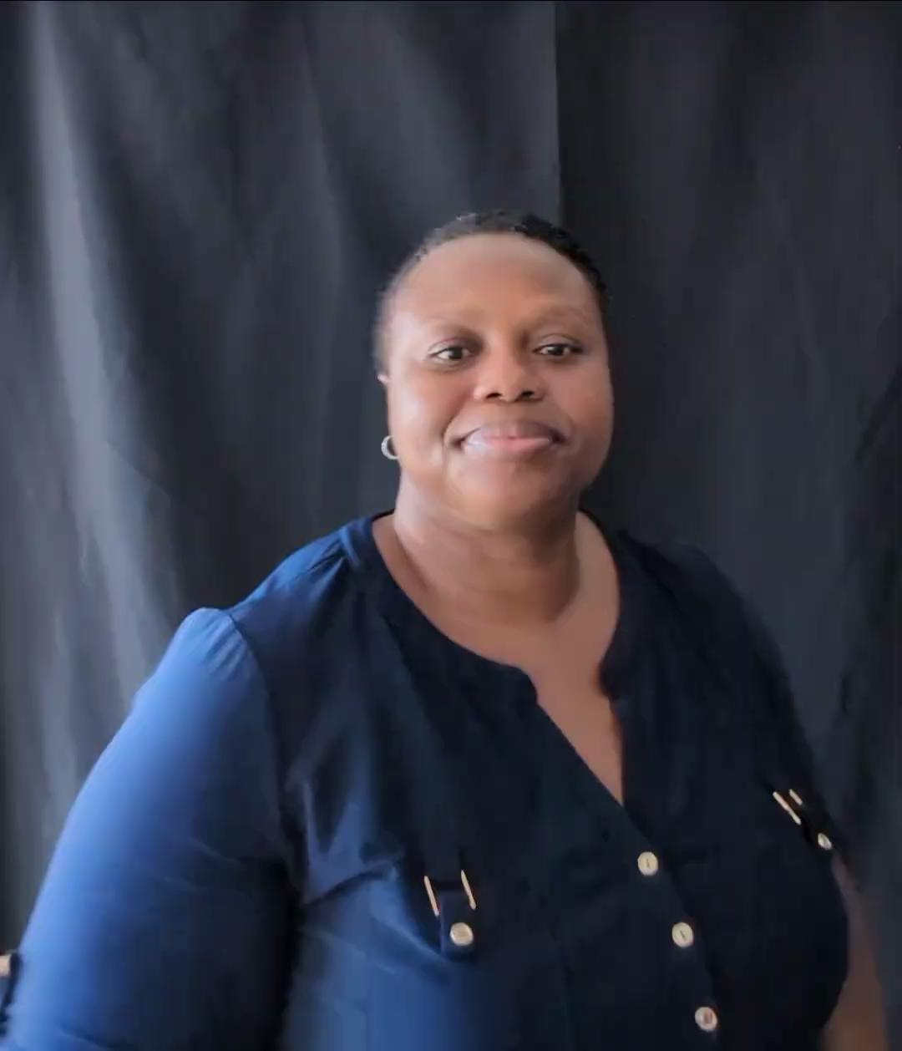
ocean

Slide 23
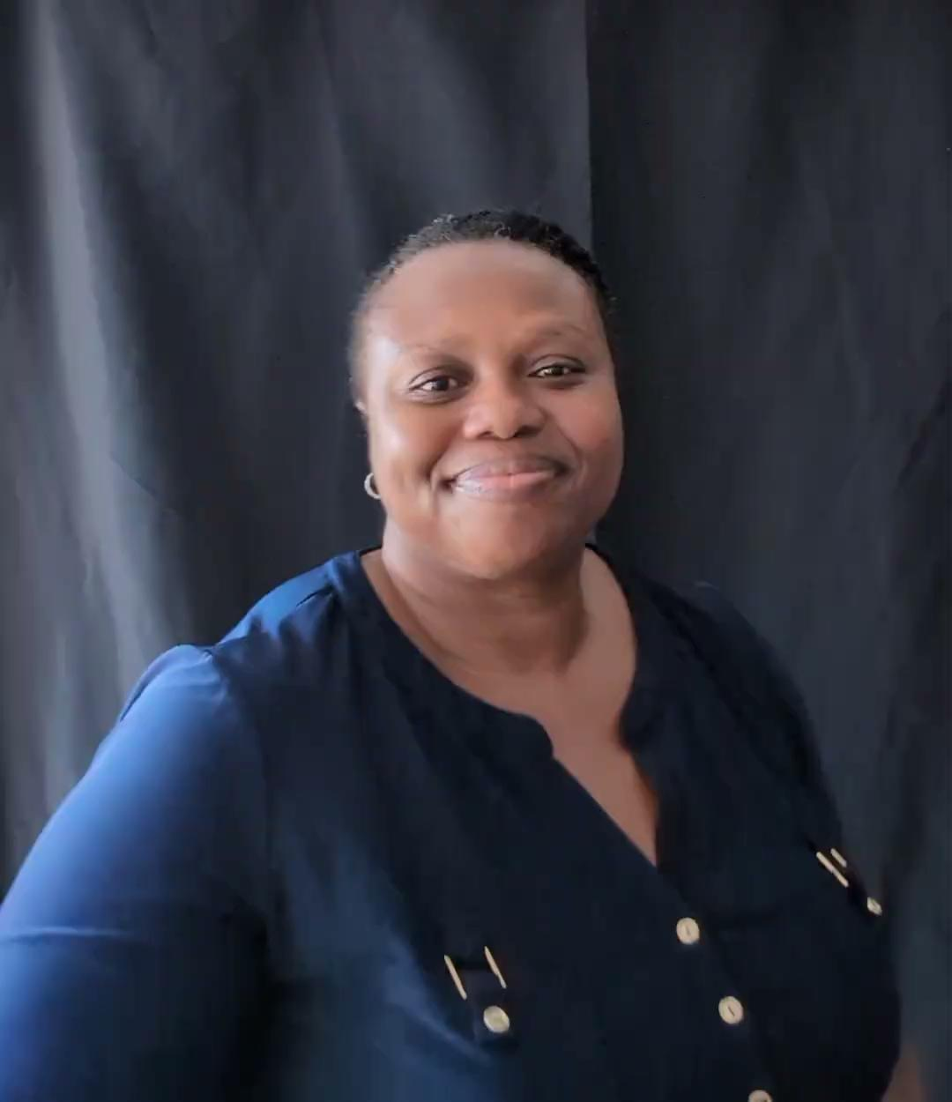
rain

Slide 24
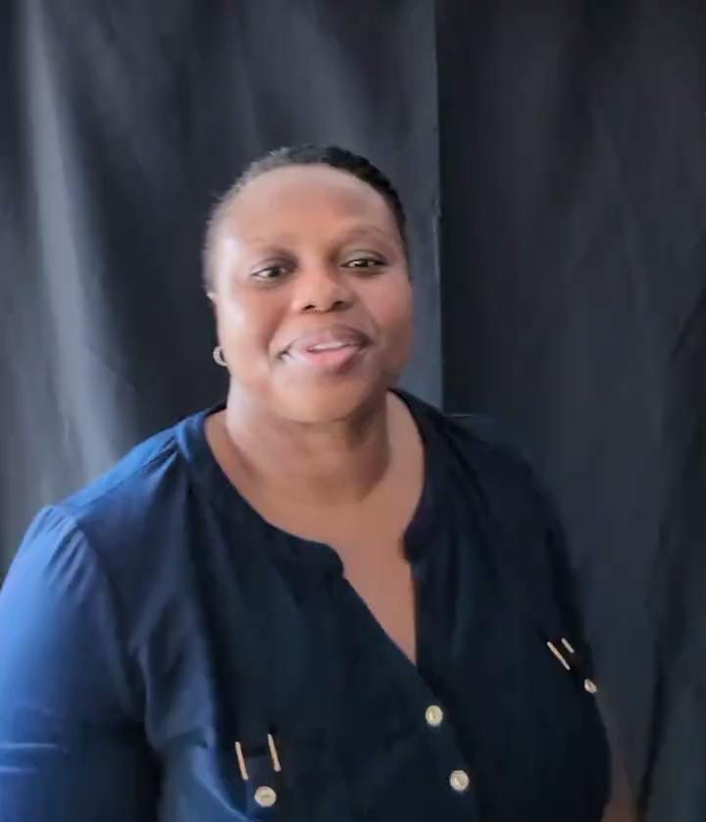
tree

Slide 25
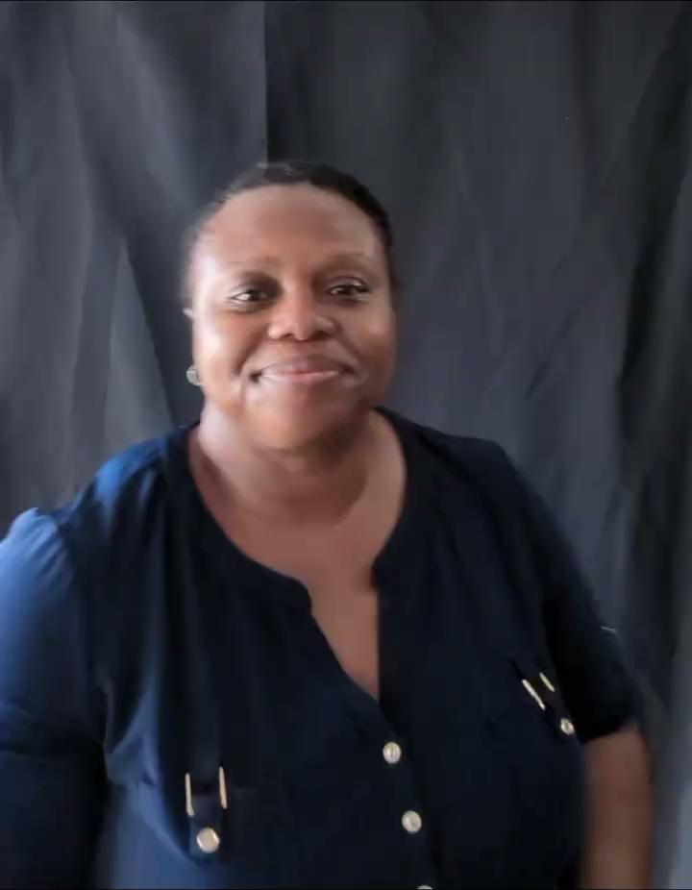
Plant 1

Slide 26
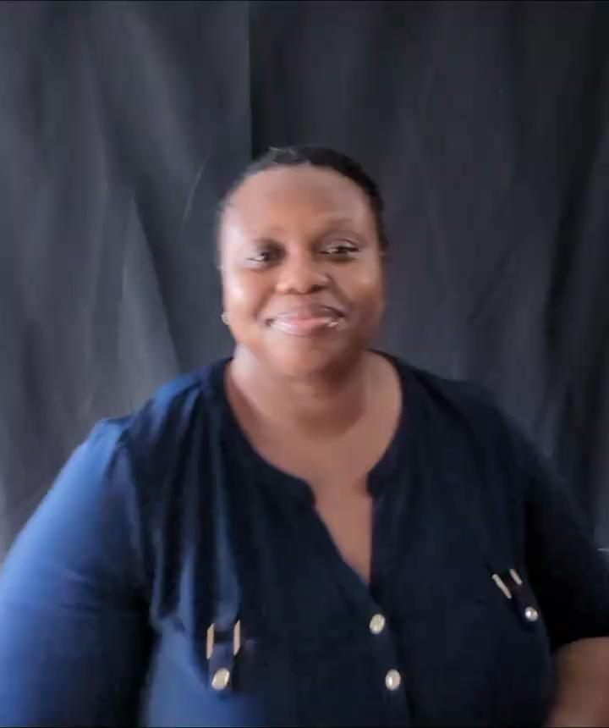
Plant 2

Slide 27
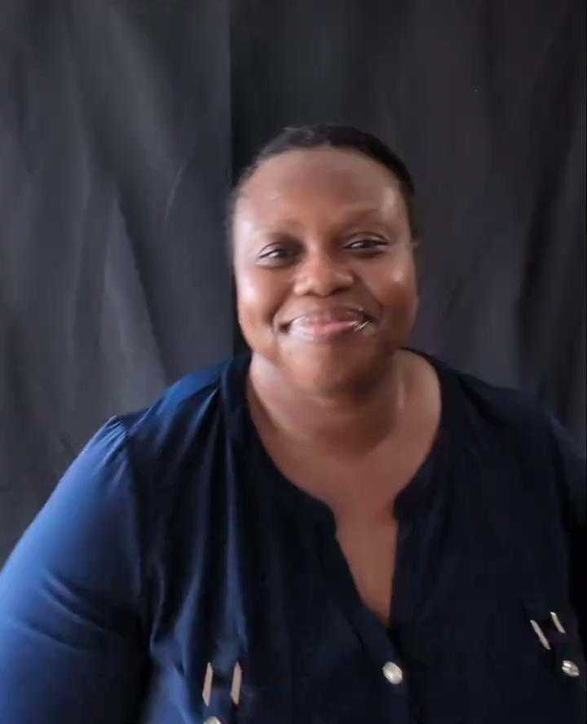
cloud

Slide 28
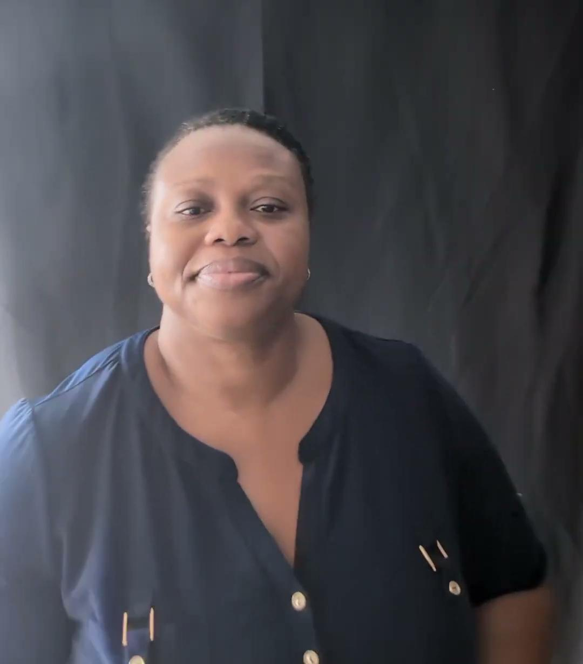
Vocab. 4
“Living Creatures”
animal, bird, insect, and people

Slide 29
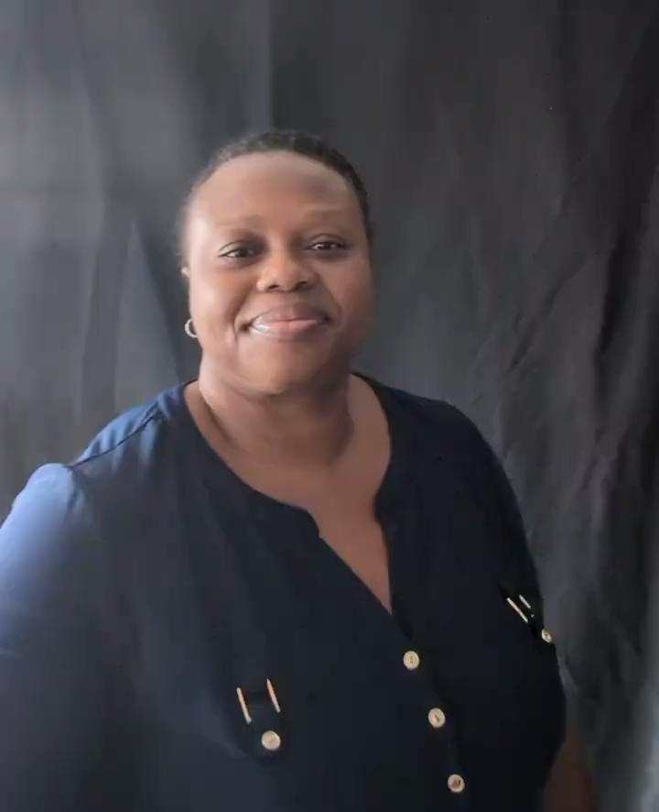
animal

Slide 30
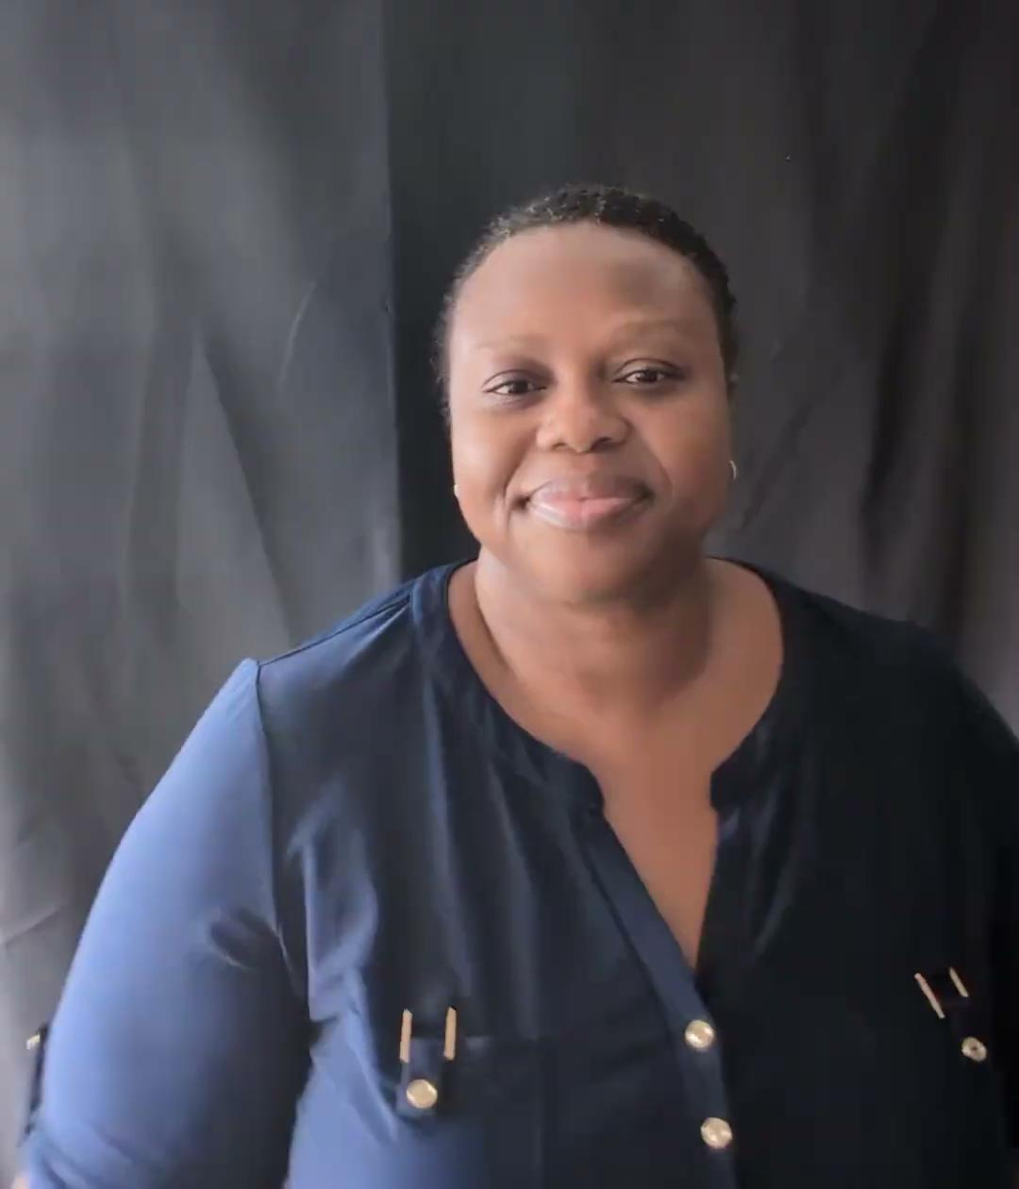
bird

Slide 31
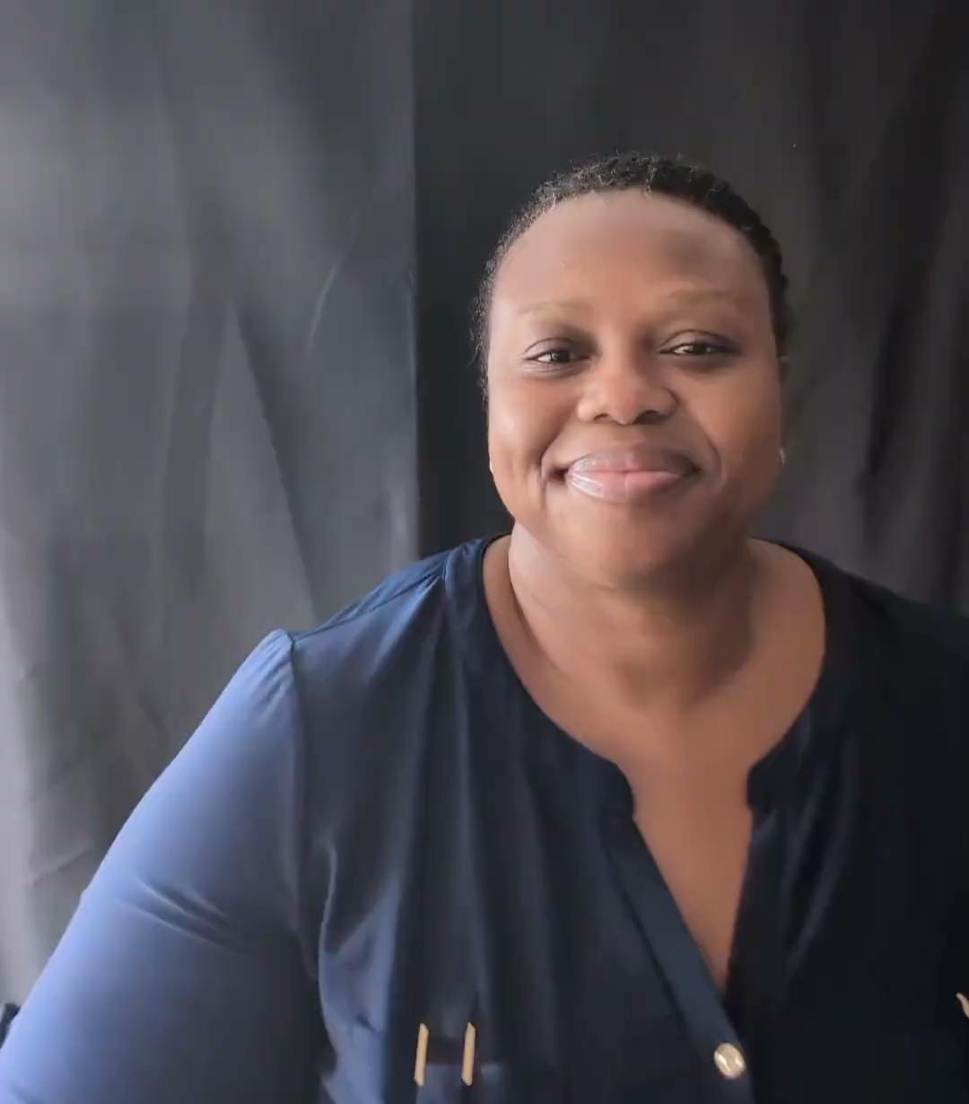
insect

Slide 32
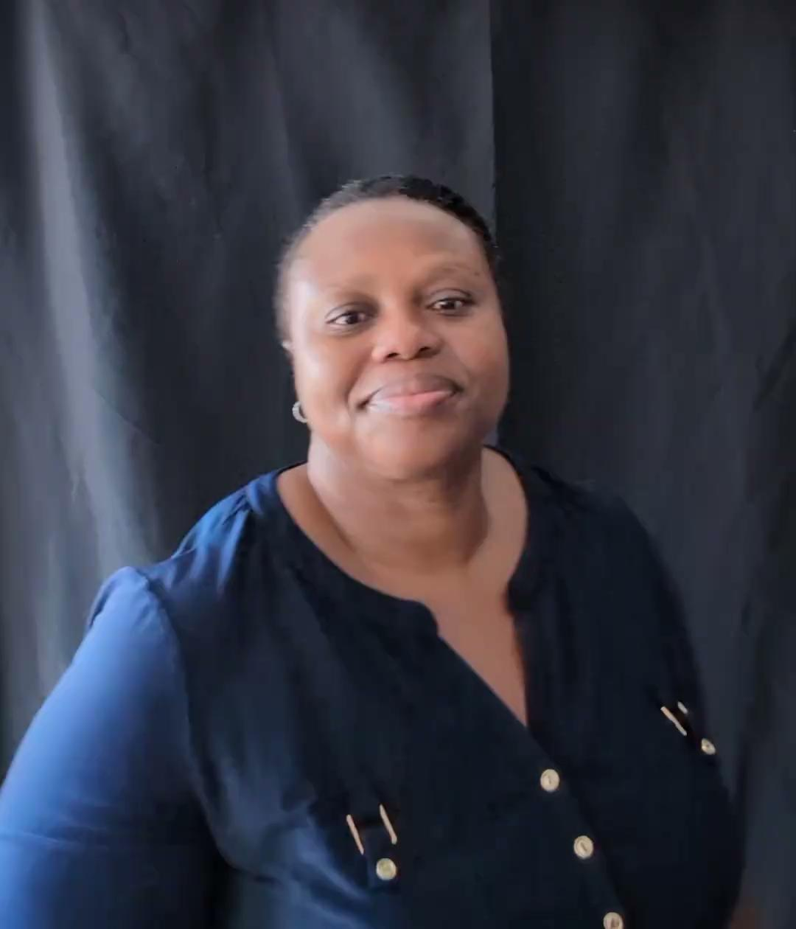
people

Slide 33
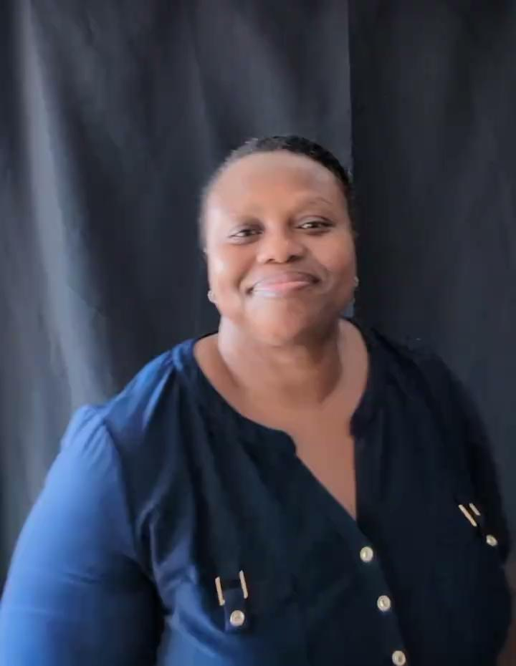
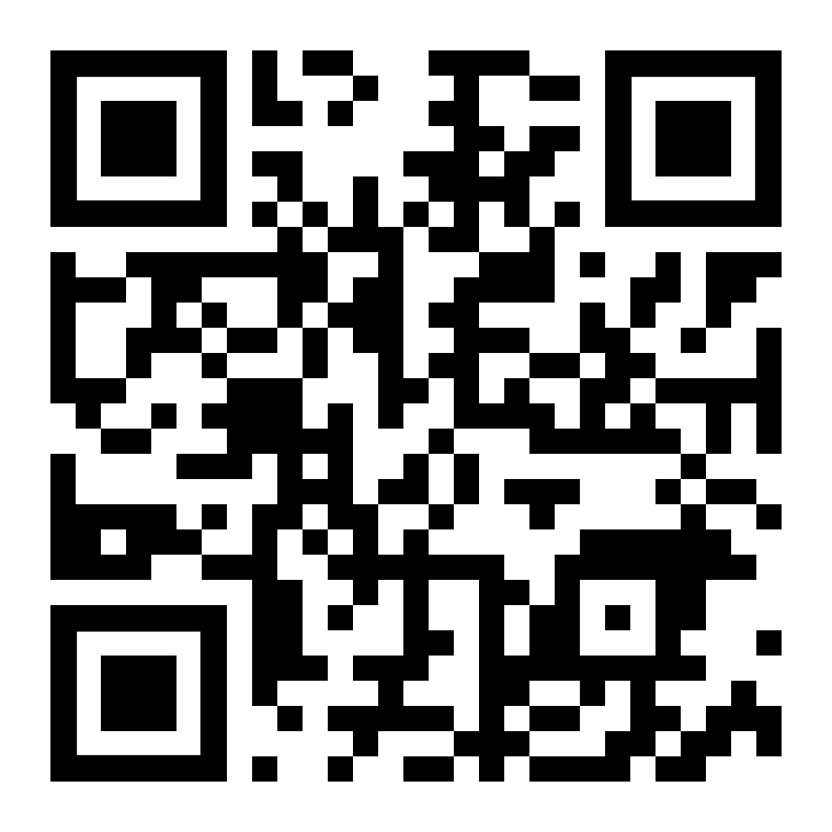
THANK YOU FOR WATCHING!!
www.ayorkoradjei.com

